Slide 1
HOBBIES CLUB

Slide 2
ABSTRACT
The hobbies club is a website developed to manage all the hobbies which are going to be take place in Telanagana , such as weekend vibes , night out Hyderabad , books exhibition , trecking and many more.
In this web site we will provide the basic information about a particular hobbies such as event organizer , event time, , event place, cost of tickets , number of tickets sold .
This project is developed using ASP.net web application and SQL database..

Slide 3
INTRODUCTION
The introduction to our project ”HOBBIES CLUB” is to take people into a place of peace and Enjoyable environment
The hobby club was established in New York in 1908 as an exclusive gentlemen’s club for people with an amateur’s hobby.
This website shows popular ongoing activities which are going to be take place in Telangana State. Such as books exhibition , cricket , Night out Hyderabad , dj events and many more.
The people from different Reqions from telanagana state can go through the events.
All the people need to do is that, go through our website get the required information and take a part in that, and make it successful.
According to its constitution “This club shall be called THE HOBBY CLUB. The object of the club shall be to encourage the collection of literacy, artistic and scientific works to aid in the development of literacy, artistic and scientific matters, to promote social and literary intercourse among its members and the discussion and consideration of various literary and economic subjects.

Slide 4
MODULE DESCRIPTION
ADMIN MODULE: The role of an admin is to manage all the activities going to take part in our state..he need to login with his respective account select the category of hobbies and the select the type of event and update all the information as per
Requirement and then logout.
USER MODULE: The role of user is to just get the basic rid of information of an hobbies. all he need to do is login with is account , if he don’t have an account create an account and then login. And select the category of an hobbies and then select an event from list and get the information and then logout

Slide 5
ER-DIAGRAMS
Login/register
Login/register
Select the category of hobby
Select the category of hobby
Select the type of event
Select the type of event
Update the info
Get the info
user
admin
Log out
Log out

Slide 6


Slide 7
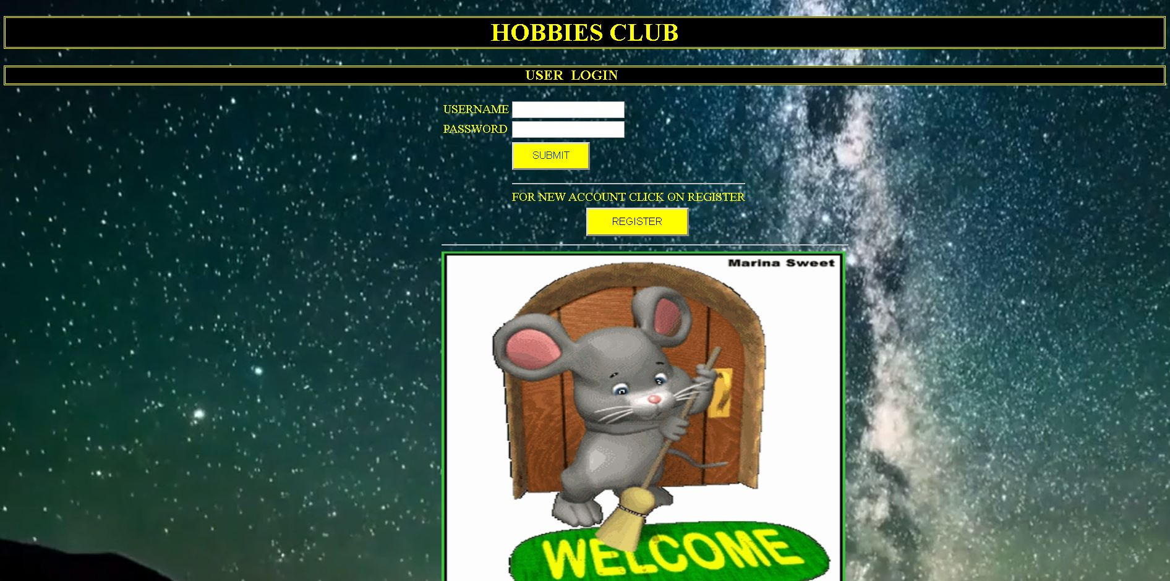

Slide 8
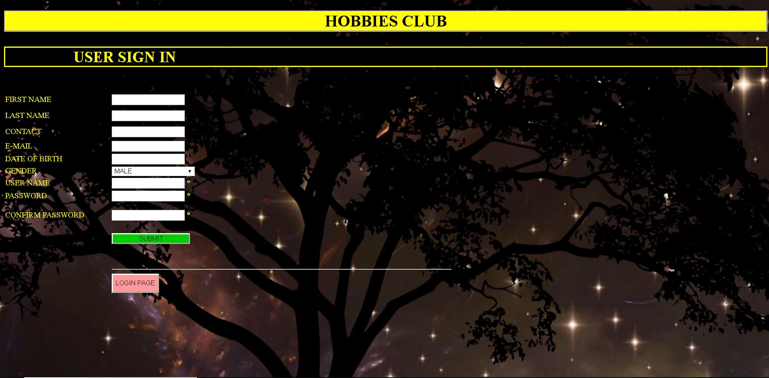

Slide 9
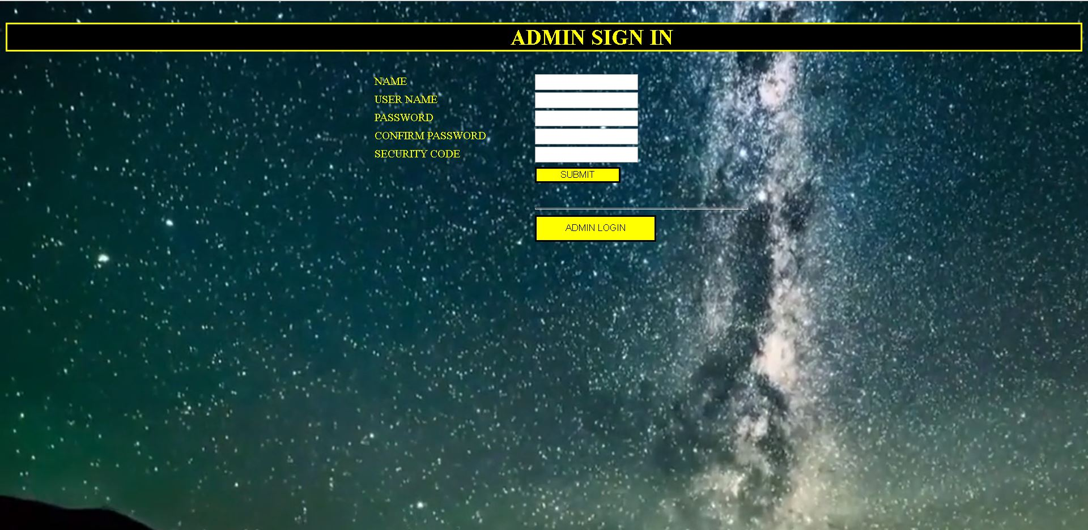

Slide 10
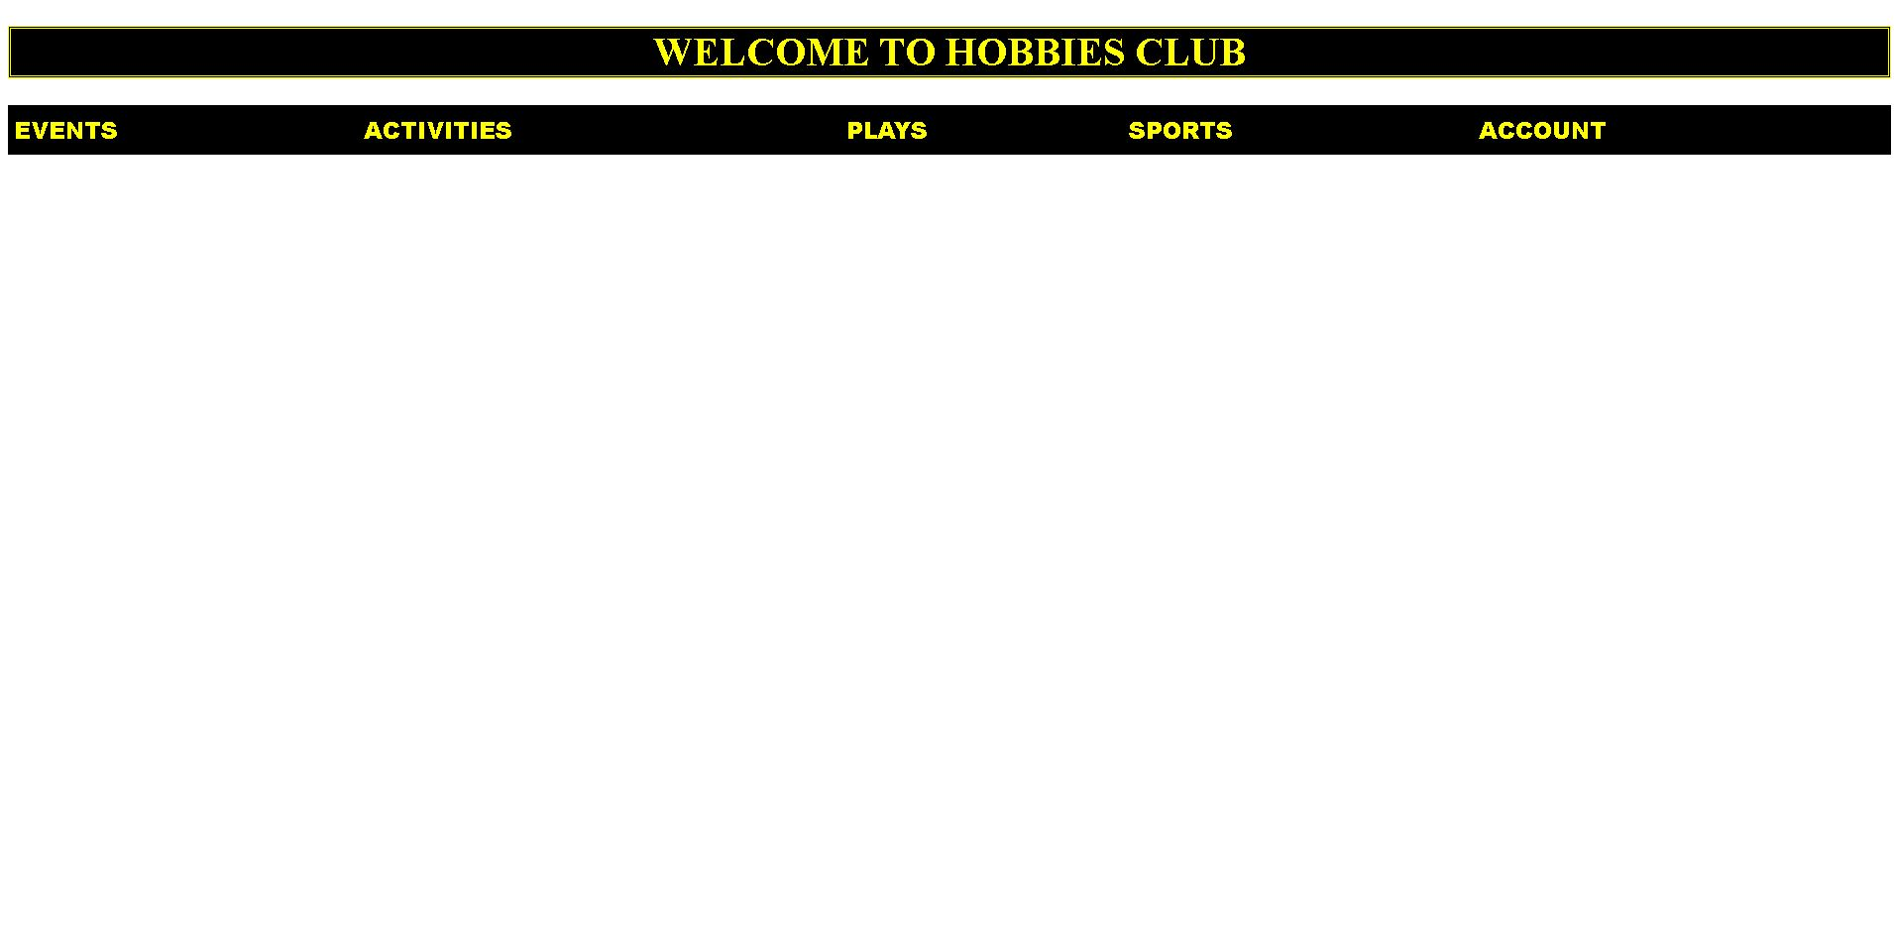

Slide 11
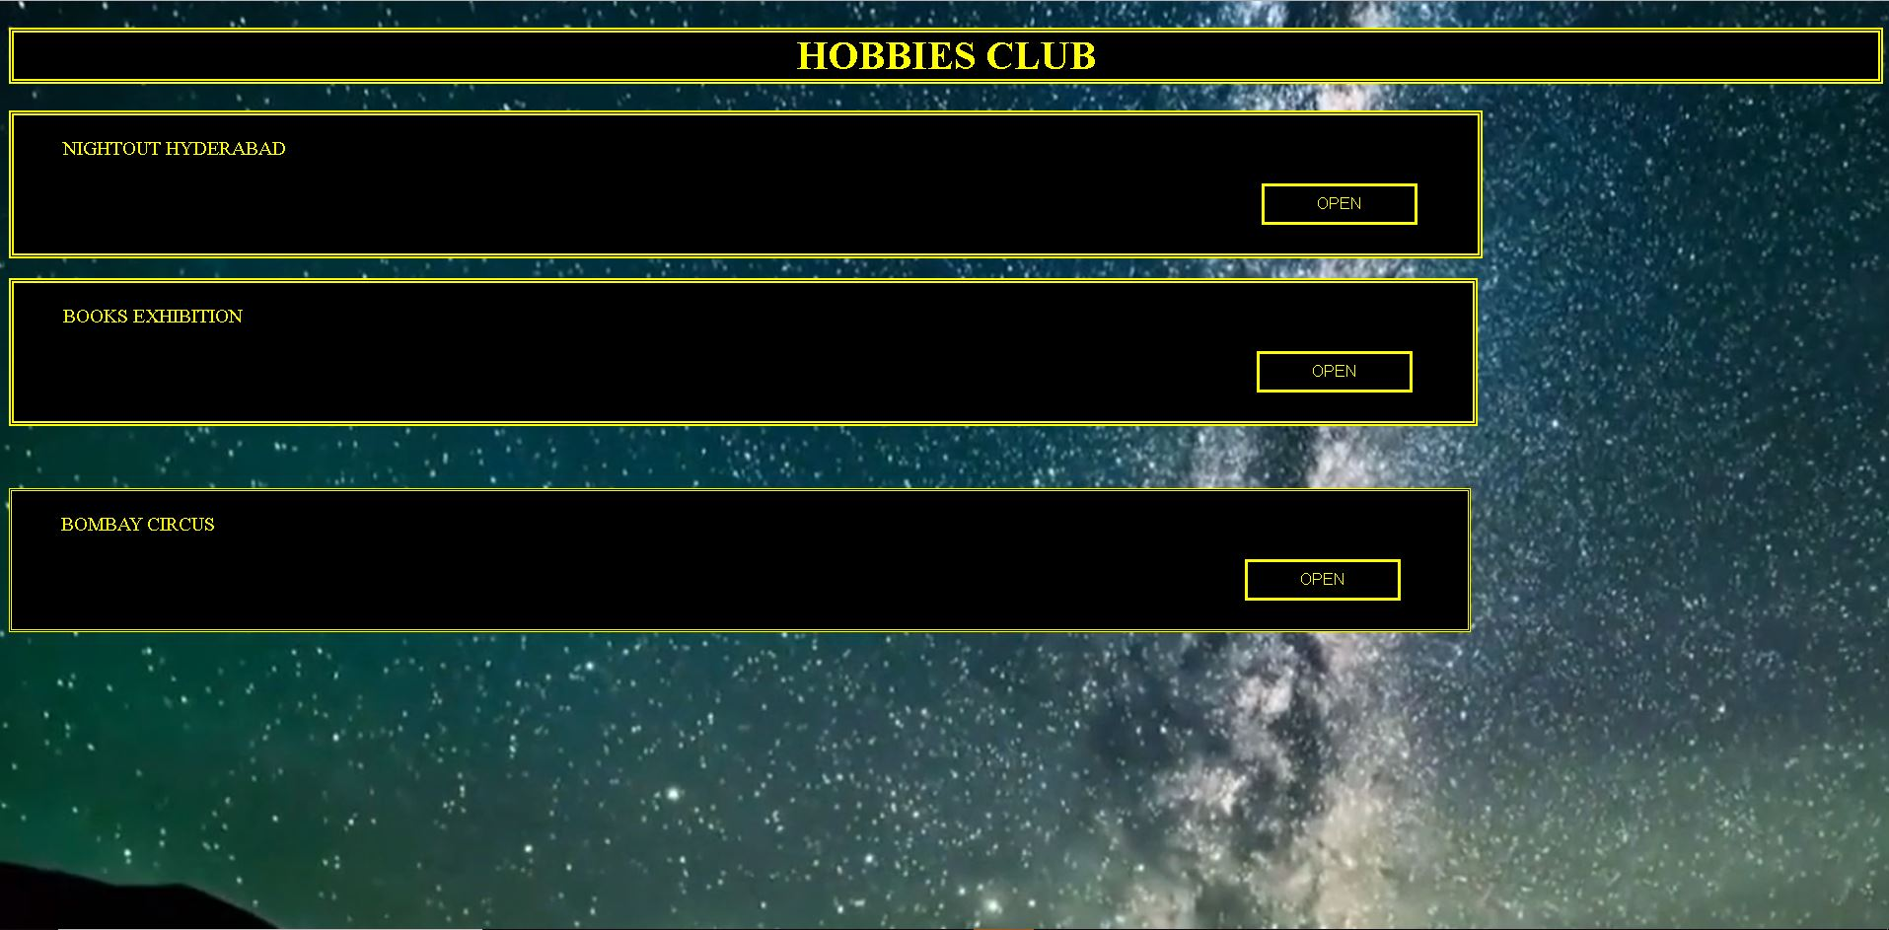

Slide 12
